Slide 1


FINTECH
&
Human evolution
Copyright © 2018. Peter Leow Consulting & its affiliates. All rights reserved.

Slide 2
What is FinTech?
-As one service provider correctly puts it-
When a service makes use of both finance and technology, it is FinTech.
i.e. paying a meal using mastercard
2
Copyright © 2018. Peter Leow Consulting & its affiliates. All rights reserved.

Slide 3
2 Years Ago..
I obtained valuable insights from an ACCA board member and shared briefly on my FB post about the major shift in global market when back then, the trend was for MNCs and businesses to go regional in a bid to capitalise on cheaper labour costs overseas.
Now, this is the norm.
At the Post Budget 2016 Convention, Senior Analyst, Senior Vice President (presently Executive Director) Mr Irvin Seah of DBS Group presented a grim outlook on the Global economy showing the all-in-the-red figures. This led him saying (after a long pause) "There will be Spring.. only after winter. The question is then, how long will the winter last?" And "if you are holding onto any stock, you may want to pray to your religion.“
Copyright © 2018. Peter Leow Consulting & its affiliates. All rights reserved.

Slide 4
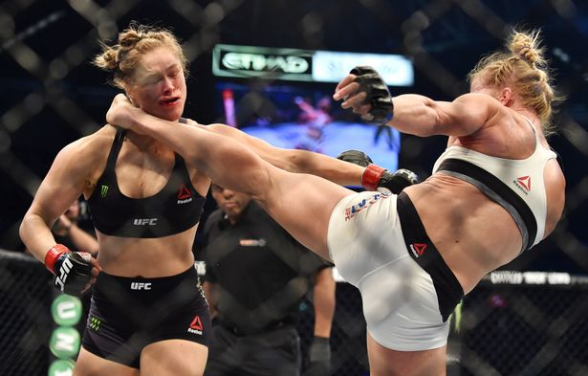
I appreciate Mr Seah's blunt sharing of the gloomy global markets as it definitely beats to be in a state of denial, akin to the championship match of November 2015 when former UFC Bantamweight Champion Ronda Rousey lost in unglam fashion in what was dubbed as history biggest upset loss to Holly Holmes. Part of the underlying reason was the incorrect information her team fed her during the match-break telling her she was winning when in fact, she was losing precious points.
Copyright © 2018. Peter Leow Consulting & its affiliates. All rights reserved.

Slide 5
Waking Up to Reality
So Mr Seah's keynote message is about the upcoming recession mostly attributed to China's shrinking economy with major bad decisions on 2 fronts last year causing The Fed and the world to spin all over the place. "For every pair of eyes you are looking at Malaysia, you need 2 pairs of eyes to look at China." This has explained why MAS is relaxing its currency strengthening policy of late to stabilise the market situation as SGD is overvalued.
Copyright © 2018. Peter Leow Consulting & its affiliates. All rights reserved.

Slide 6
BUT..
I was looking even deeper past the recession where the Senior Analyst stopped short. Something bigger and challenging to the mass is taking place as we speak.
Technology is the Next IN Thing.
We have seen it unfolding before our very eyes when MNC brands (Big Names) are exiting out of Singapore shores in the retail industry with a simple reason. It is now an effortless process acquiring your ideal products online especially when everyone is carrying a mobile. Yet I read with a pinch of salt of an article from Yahoo few months ago (2015) that online shopping is not affecting the retailers' business outlet and they somehow have the statistics to show it.
One thing is certain, statistics is inconsistent with what is happening right now with big players pulling out of the market scene. Perhaps due to tight/unrealistic dateline of Journalist to report their findings, the survey conducted was not extensive enough to represent the population. The downside of it is a less credible news which is becoming increasingly common these days and one has to verify the facts from several independent and credible sources before deriving any conclusion. I remember vividly our late Founding Father Mr Lee Kuan Yew's criticism towards a Journalist, 500 does not mean anything, it is too small a number to represent the population.
Copyright © 2018. Peter Leow Consulting & its affiliates. All rights reserved.

Slide 7
Double Whammy!
In recent weeks, we read about Google introducing driverless cars in Singapore end of the year and another article about a Chinese Tycoon flaunting his wealth as he was accompanied by 8 'Artificial Intelligence' robotic maids instead of bodyguards, in his shopping spree in China.
While the top-of-the-chain manufacturer/designer of robots/Cloud platforms are earning Top Dollars, sadly this causes the redundancy of Human Capital. Once upon a time, Human Capital forms the backbone of any enterprise but now we are seeing a convenient replacement by Technology.
Yes, the rise of Technology is becoming so prevalent to a stage where it undermines or soon to eliminate Human Capital. It is now way cheaper to operate business without a physical office. We may even branch off to an Era where everyone works on their own without office space.
My question is this..can Humanity hope to survive a Double Whammy?
Even if our generation may not see the rise of machines (being programmed/configured to do operational work) materialise but what about the next generation? Surely times will get even tougher than we could possibly comprehend unless we start training our kids from young to deal with hardship hoping they will (can) last in an unthinkable Era.
Copyright © 2018. Peter Leow Consulting & its affiliates. All rights reserved.

Slide 8
Present Day..
We Evolved
Copyright © 2018. Peter Leow Consulting & its affiliates. All rights reserved.

Slide 9
AR Concept
PLCO’s
Towards FinTech
Rejection
Resistance
Acceptance
Resilience
Fiction / State of Denial
Strong Opposition
Adaptability
Evolution
Classify Technology as Fiction and can never replace Human Capital.
Induction of Technology into Singapore striving towards a Smart Nation faced heavy resistance.
Majority follow as a result of inception of technology into businesses. Nobody want to be left out.
An integral part of our lives. We evolved.
Copyright © 2018. Peter Leow Consulting & its affiliates. All rights reserved.

Slide 10
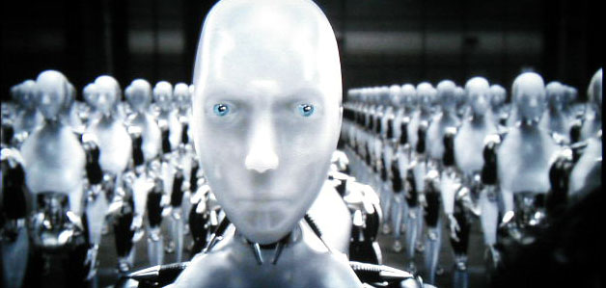
Rejection Stage
Nobody believes that technology can replace human capital and classify film like i-Robot as fiction.
10
Copyright © 2018. Peter Leow Consulting & its affiliates. All rights reserved.

Slide 11
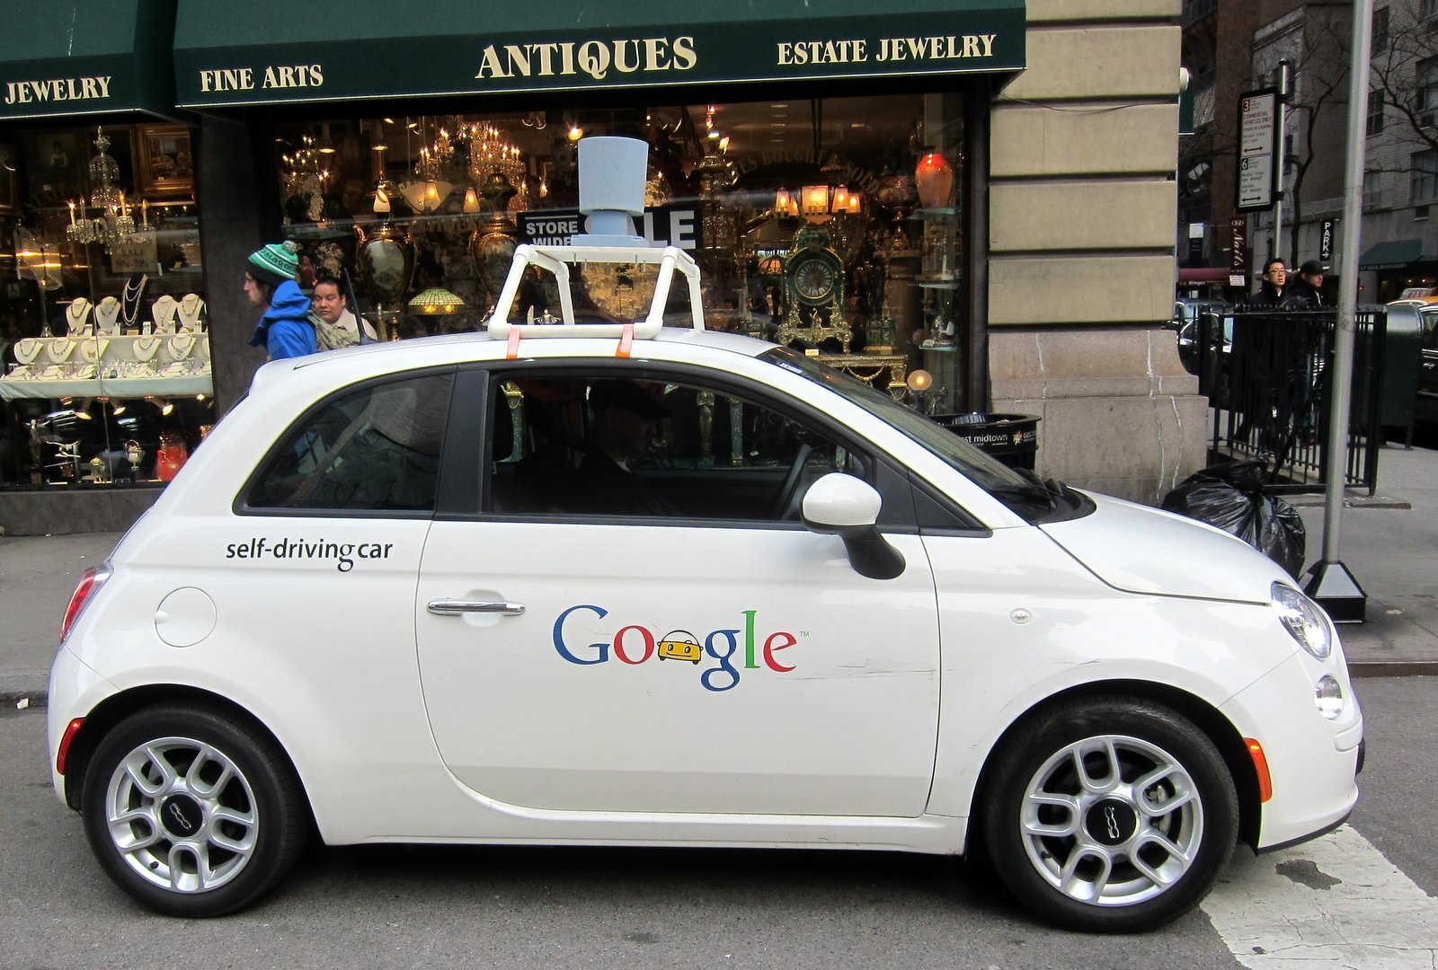
Resistance Stage
Advancement of technology breaks the norm that it is a myth and majority reject the idea.
11
Copyright © 2018. Peter Leow Consulting & its affiliates. All rights reserved.

Slide 12

Aceptance Stage
Growing acceptance of technology to be an essential part of life.
Fear of falling behind or becoming obsolete if we don’t follow suit.
12
Copyright © 2018. Peter Leow Consulting & its affiliates. All rights reserved.

Slide 13

Resilience Stage
Incorporating technology into key processes in business to enhance productivity and maximise output.
No longer an option but it’s a DO or DIE approach.
13
Copyright © 2018. Peter Leow Consulting & its affiliates. All rights reserved.

Slide 14

Conclusion
Let us help you with the Compliance aspect while you divert resources to look at ways to innovate your key business processes using Technology.
Engage Us Now!
Copyright © 2018. Peter Leow Consulting & its affiliates. All rights reserved.

Slide 15
Thanks!
Peter Leow
CEO, Strategist
CA Singapore
Peter Leow Consulting Pte Ltd (Part of CPA Group)
Copyright © 2018. Peter Leow Consulting & its affiliates. All rights reserved.

